Slide 1
Child & Dependent Care Credit
Pub 17 Chapters 3 & 32
Pub 4012 Tab G
(Federal 1040-Line 49)
Notes:
1

Slide 2
Child & Dependent Care Credit – 1040 Line 49
Can deduct portion of child care expenses if:
Pay for care in order to work or look for work
Have a qualifying person
Only custodial parent may claim credit, even if non-custodial parent can claim exemption under rules for divorced & separated parents
Limit on expenses to claim is $3,000 for 1 qualifying individual or $6,000 for 2 or more
It is possible for 1 qualifying person to have 0 expenses and another qualifying person to have expenses > $3,000. $6,000 limit applies
Credit can be 20% to 35% of expenses, based on earned income & AGI
Use Form 2441 to calculate credit
Notes:
The Child & Dependent care credit is a percentage of expenses claimed.
2

Slide 3
Requirements for Child & Dependent Care Credit
Pub 4012 Tab G
Taxpayer must pass 5 tests to claim:
Qualifying Person Test
Earned Income Test
Work-Related Expense Test
Joint Return Test
Provider Identification Test
Use Decision Tree, Pub 4012 Page G-6
Notes:
3

Slide 4
Child & Dependent Care Credit: Qualifying Person Test
Child who was under age 13 when expenses were incurred and who can be claimed as dependent
Your disabled spouse incapable of self-care
Any other person incapable of self-care and
Can be claimed as your dependent OR
Would have qualified as your dependent except:
his income exceeded $4,050
he filed a joint return
taxpayer/spouse could be claimed as dependent on another return
Notes:
4

Slide 5
Child & Dependent Care Credit: Qualifying Person Test
(cont’d)
Qualifying person must live with taxpayer more than half the year
Taxpayer does not have to pay over half the cost of keeping up a home for the qualifying person
If Dependent Care Benefits are listed on W-2 Box 10, must complete Form 2441. Otherwise, benefits count as taxable wages
Notes:
5

Slide 6
Child/Dependent Care Credit: Earned Income Test
Taxpayer (& spouse) must have earned income – wages, tips, &/or net self-employment
Exceptions for disabled or full-time students who are unable to work
Complete the Addition to Income worksheet for non-working spouse
Addition to income is only used to calculate this credit; is not actually added to income on 1040
Notes:
6

Slide 7
Child/Dependent Care Credit: Work-Related Expense Test
To qualify for credit, expenses must:
Allow taxpayer (& spouse) to work or look for work
Be for a qualifying person’s care
Not work-related expenses
Expenses cannot be:
Expenses for food, clothing or entertainment
Education expenses to attend kindergarten or higher grade
Cost of sending child to an overnight camp
Cost of day camp may count
Cost of transporting a qualifying person from taxpayer’s home to care location & back
Notes:
7

Slide 8
Child/Dependent Care Credit: Joint Return Test
Generally, married couples who wish to take the child & dependent care credit must file a joint return
However, an allowable exception are taxpayers who are considered unmarried if they file a separate return and:
are legally separated on the last day of tax year (Single) OR
lived apart from their spouse for the last 6 months of the year & paid more than half the cost of providing a home which was also the main home of the qualifying person for more than half the year (HOH)
Notes:
8

Slide 9
Child/Dependent Care Credit Provider Identification Test
Must have Provider Identification info
Form W-10 “Dependent Care Provider ID & Certification”
Social Security card
If provider is household employee, need copy of provider’s W-4
Must show due diligence if no ID
Payments to your own children under age 19 do not qualify
Notes:
9

Slide 10
Employer-Provided Child/Dependent Care Benefits
Check W-2’s carefully for Dependent Care Benefits (DCB) – amount is shown in Box 10
If taxpayer received Dependent Care Benefits from employer, Page 2 of Form 2441 must be completed
Overall qualified expense limit of $3,000/$6,000 is reduced, dollar for dollar, by any reimbursement excluded from taxpayer’s income
Notes:
10

Slide 11
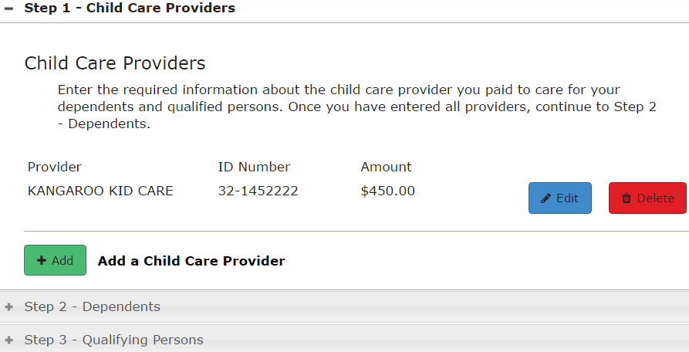
TS - Child/Dependent Care Expenses – Page 1 Federal Section \ Deductions \ Enter Myself \ Credits Menu \ Child Care Credit (Form 2441)
Total expenses must equal
total amount paid to providers
Step 1 - Enter info about provider
Step 2 – Enter info about dependents
Step 3 – Enter info about other qualifying persons
Notes:
11

Slide 12
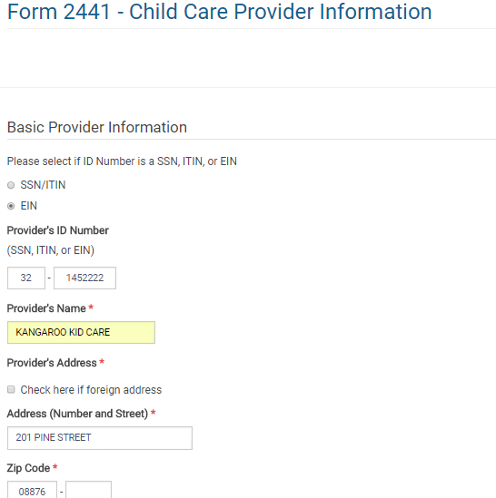
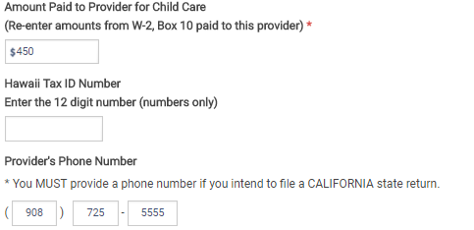
TS - Child/Dependent Care Expenses – Step 1 Federal Section \ Deductions \ Enter Myself \ Credits Menu \ Child Care Credit (Form 2441)
Provider info
Amount paid to provider for child care
Notes:
12

Slide 13
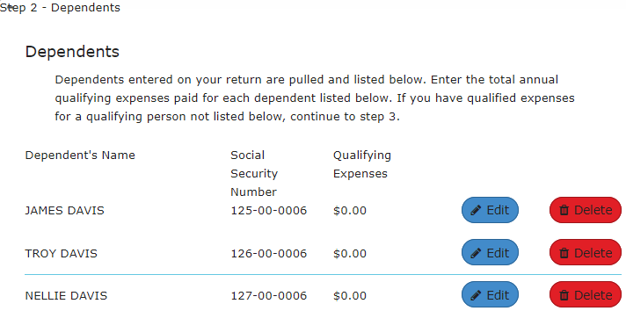
TS - Child/Dependent Care Expenses – Step 2 Federal Section \ Deductions \ Enter Myself \ Credits Menu \ Child Care Credit (Form 2441)
TaxSlayer pulls dependents from return
Choose dependent(s) who had expenses
Notes:
13

Slide 14
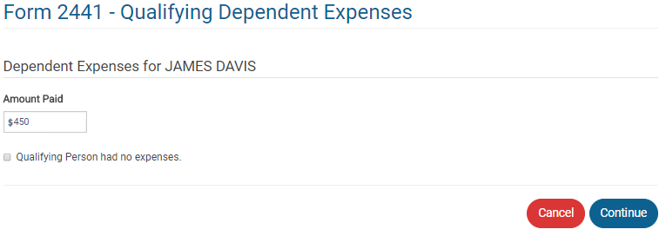
TS - Child/Dependent Care Expenses – Step 2 Federal Section \ Deductions \ Enter Myself \ Credits Menu \ Child Care Credit (Form 2441)
TaxSlayer pulls dependents from return
Child care expenses paid for this dependent
NOTE: It is possible for 1 qualifying person to have 0 expenses and another
qualifying person to have expenses exceeding $3,000. The $6,000 limit applies,
Notes:
14

Slide 15
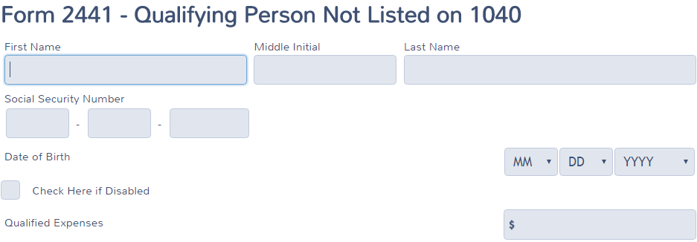
TS - Child/Dependent Care Expenses – Step 3 Federal Section \ Deductions \ Enter Myself \ Credits Menu \ Child Care Credit (Form 2441)
Info about qualified person
not listed in Step 2
Expenses for each qualified person
Notes:
15

Slide 16
TS - Child/Dependent Care Expenses – Page 2 Federal Section \ Deductions \ Enter Myself \ Credits Menu \ Child Care Credit (Form 2441)
Continue to Form 2441 Page 2 after completing Steps 1, 2, 3 on 2441 Page 1
Use to enter:
Additions to income for taxpayer/spouse who was a student or disabled (since both spouses must have earned income). Amount to add is based on:
how many months he/she was a student (or disabled) and did not work AND number of qualifying children
This additional income is for purposes of figuring Child Care credit only; not added to total income on tax return
Amount of employer-paid dependent care benefits (if not reported on W-2)
Notes:
16

Slide 17
TS – Child and Dependent Care Expenses - Form 2441, Page 1
Total expenses
Net expenses, after employer-provided benefits on W-2 Box 10
TaxSlayer calculates child/ dependent care credit
Notes:
17

Slide 18
TS – Child and Dependent Care Expenses -Form 2441, Page 2
Employer-provided benefits
Notes:
18

Slide 19
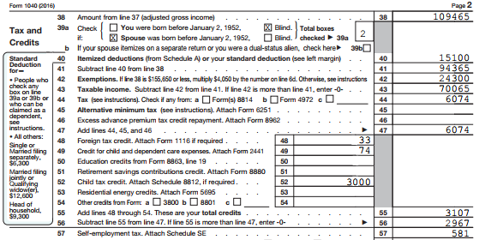
TS - Child/Dependent Care Credit – Federal 1040 Line 49
TaxSlayer transfers from Form 2441
Notes:
TaxSlayer will transfer the Child/Dependent Care Credit calculated on Form 2441 to 1040 Line 49
19

Slide 20
Child/Dependent Care Credit – Form 2441 – TS Tips
Enter in Federal Section \ Deductions \ Enter Myself \ Credits Menu \ Child Care Credit (Form 2441)
Page 1
Step 1 - Enter info on child care provider(s) and amounts paid to each provider
Step 2 – Enter expenses for each qualifying child
TaxSlayer automatically pulls children’s names from previous entries made in TaxSlayer
Step 3 – Enter info and expenses for any other qualifying person not listed on 1040 previously
Notes:
20

Slide 21
Child/Dependent Care Credit – Form 2441 – TS Tips
(cont’d)
Page 2
Enter additions to income for taxpayer/spouse who was a student or disabled (follow TaxSlayer instructions to determine amount to add)
Enter amount of employer-paid dependent care benefits (if not reported on W-2)
TaxSlayer calculates allowable credit on Form 2441 and transfers to 1040 Line 49
Notes:
21

